Slide 1

Prediction of Adult Obesity in the ​ United States​
Ayushi Yadav, Pratik Pachpute, Monika Kommareddy, Zhenjun Wang
Harrisburg University of Science and Technology
ANLY 502: 502 - Analytical Methods - I

Slide 2
Rising Scenario of Obesity
The prevalence of obesity has risen and continues to rise in the United States over the last two decades​.
Obesity affects more than one-third of the population in the United States​.
Obesity is associated with an increased risk of more serious diseases​.
Knowing the factors that contribute to obesity can be helpful for the healthy lifestyles​.

Slide 3
Data Set Description
S. No. | Exploratory Variables
1 | % smokers
2 | # Full-service restaurants
3 | Fast-food expenditures per capita
4 | % Households no car &<1 mile to store
5 | % eating few fruits and vegetables
6 | Lbs per capita meat & poultry
7 | Adult obesity rate
8 | Rec & fitness facilities/1,000 pop
9 | Lbs per capita solid fats
10 | Median household income
11 | Sum of % who do not exercise
12 | Sum of Chip & pretzel sales tax, vending
13 | Lbs per capita pkg sweet snacks
14 | Gals per capita soft drinks
15 | Fast-food restaurants/1,000 pop
16 | Lbs per capita prepared meals
17 | Relative price of sweetened drinks
18 | Poverty rate
19 | Price ratio fruit/pkg sweet snacks
20 | Price ratio fruit/pkg savory snacks
21 | Price ratio green-leafy/starchy veg
22 | % Students reduce-price-lunch eligible

Slide 4
Exploratory Data Analysis​
Data were retrieved from the USDA – United States Department of Agriculture.​
Approach​:
Observing General Obesity Trends State wise​
Correlations Plot – Check for Multicollinearity.​
Data Cleaning – Removing Outliers with Leverage, Mahalanobis and Cooks scores​
​

Slide 5
Data Screening
Accuracy and Missing Data​
No missing data​
Outliers​
2 outliers for leverage​
3 outliers for cooks ​
2 outliers for Mahalanobis​
total outliers = leverage + cooks + Mahalanobis​
Noout <- subset(master11, total outliers < 2)​
Additivity​
The correlation between variables is all less than 0.9, meeting the assumption ​
Normality​
Since the skewness for a normal distribution is 0, treat it as normal​
Linearity ​
Most points close to the line​ Homogeneity and Homoscedasticity residuals look evenly spread​

Slide 6
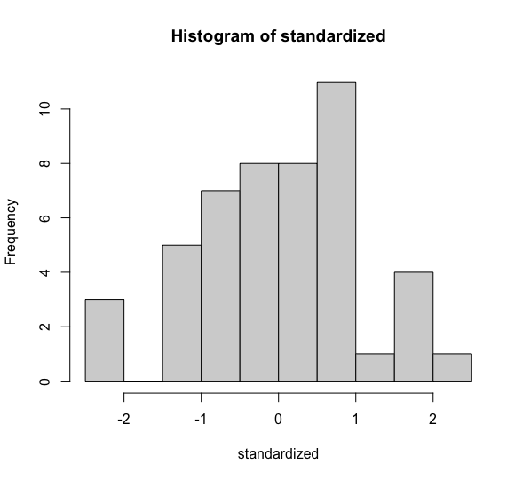
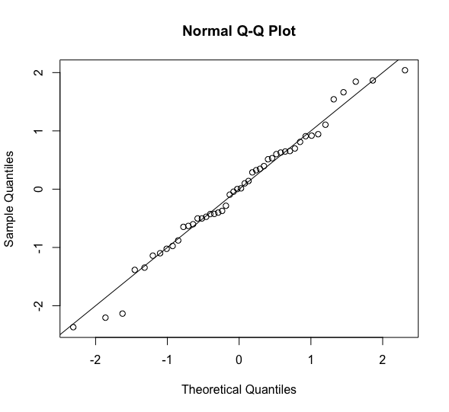
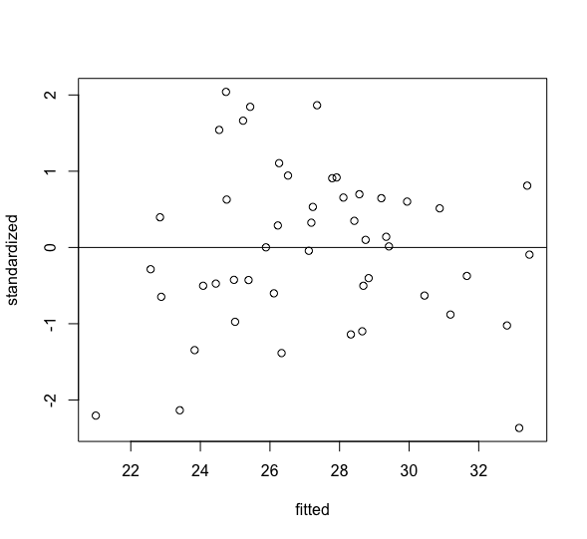
Normality
Linearity
Homogeneity & Homoscedastic

Slide 7
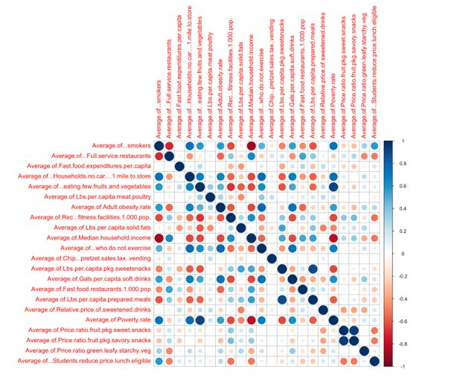
Correlation Plots:
​Considering IV with a correlation of more than 60%. ​
DV: Obesity​
IV's: no_car_<1mile, household_income, No_exercise, Gallons_soft_drinks, smokers, poverty rate​.

Slide 8
The “Best” Model​
Model | Variables Considered | R-2 | Prediction Accuracy | Comments
1. | Smokers no_car No_exercise Gals_soft_drinks Poverty_rate | Multiple – 0.8428 Adjusted – 0.8241 | MAPE – 0.049 RMSE – 1.67
2 | Poverty Rate | Multiple – 0.369 Adjusted – 0.3563 | MAPE – 0.09 RMSE – 2.91 | Only Poverty Rate
3. | Smokers Poverty Rate No_exercise Gals_soft_drinks | Multiple – 0.8349 Adjusted – 0.8196 | MAPE – 0.055 RMSE – 1.599 | Dropped no_car

Slide 9
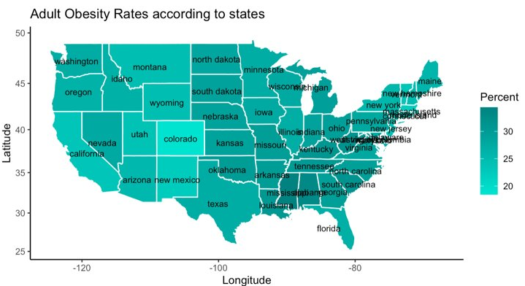
The “Best” Model​
We have obesity rate as the Dependent variable(DV), we measured the correlations of all other variables (Independent variables) against the DV to select the IVs with a correlation coefficient greater than 0.6​
Model:
obesity ~ Smokers + no_car + No_exercise + Gals_soft_drinks + Poverty_rate
Regression Equation:
-19.804 + 0.208*Smokers – 0.466*No_car + 1.78*No_exercise + 0.100*Gals_soft_drinks - 0.345*Poverty_rate​
The effect size for our model is 0.8428

Slide 10
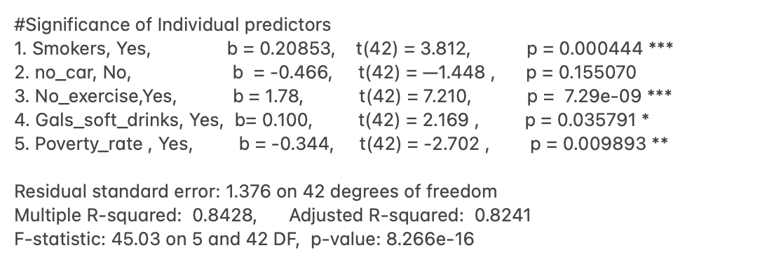
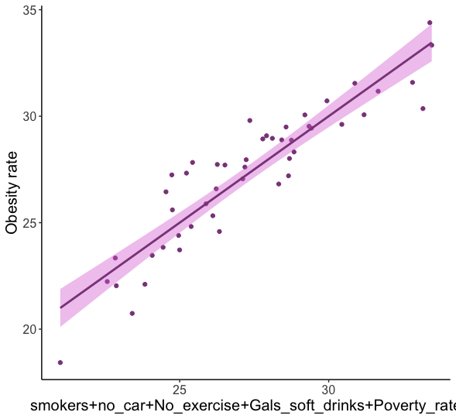

Slide 11
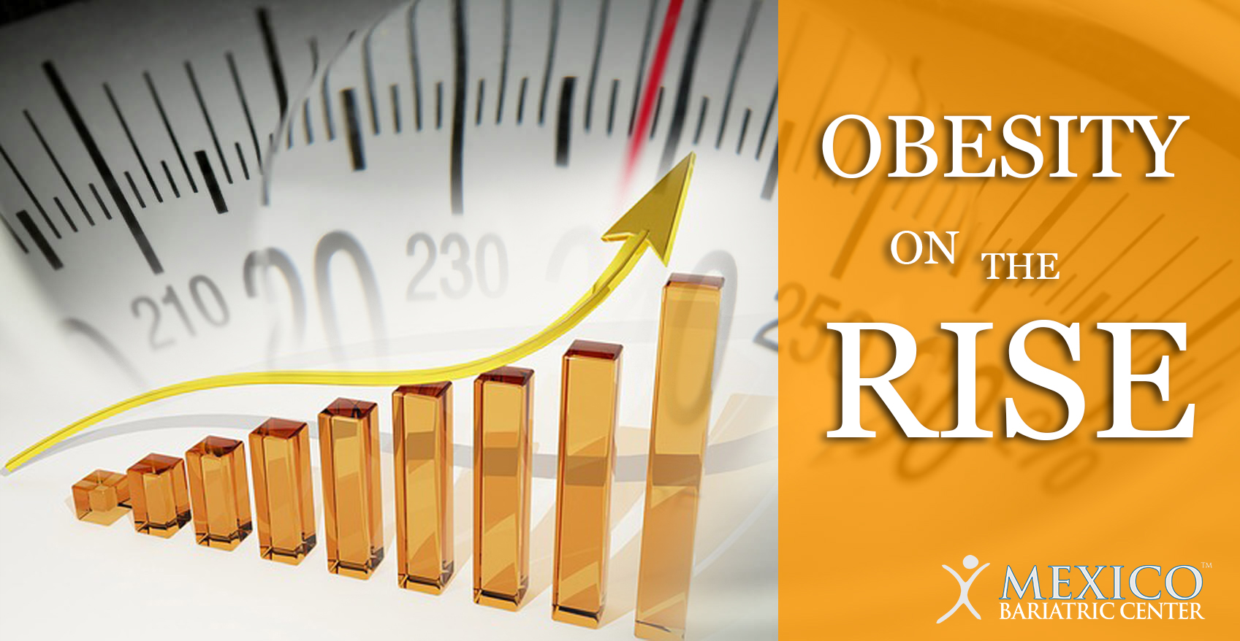
Inference​
Examining the impact of Smoking rates on Obesity.
Null Hypothesis​ (Ho) – Smoking is not a significant predictor for our model used to predict obesity​
Alternate Hypothesis​ (H𝛼) – Smoking is a significant predictor for our model used to predict obesity​

Slide 12
Prediction
Obesity Rates increase after increasing our
significant variables by 5%.
There is a mean increase of 2 % with an increase of 7.6% in the Adult Obesity rates just by increasing our recourse ​
MAPE – Mean Absolute Percentage Error – 0.049
RMSE – Root Mean Square Error – 1.6

Slide 13
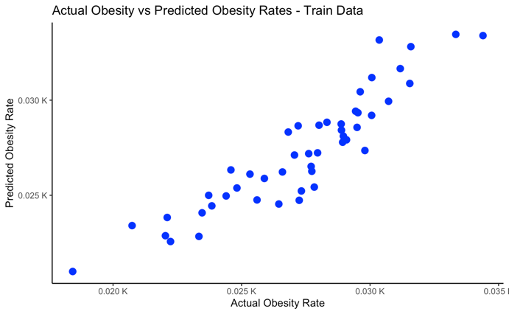
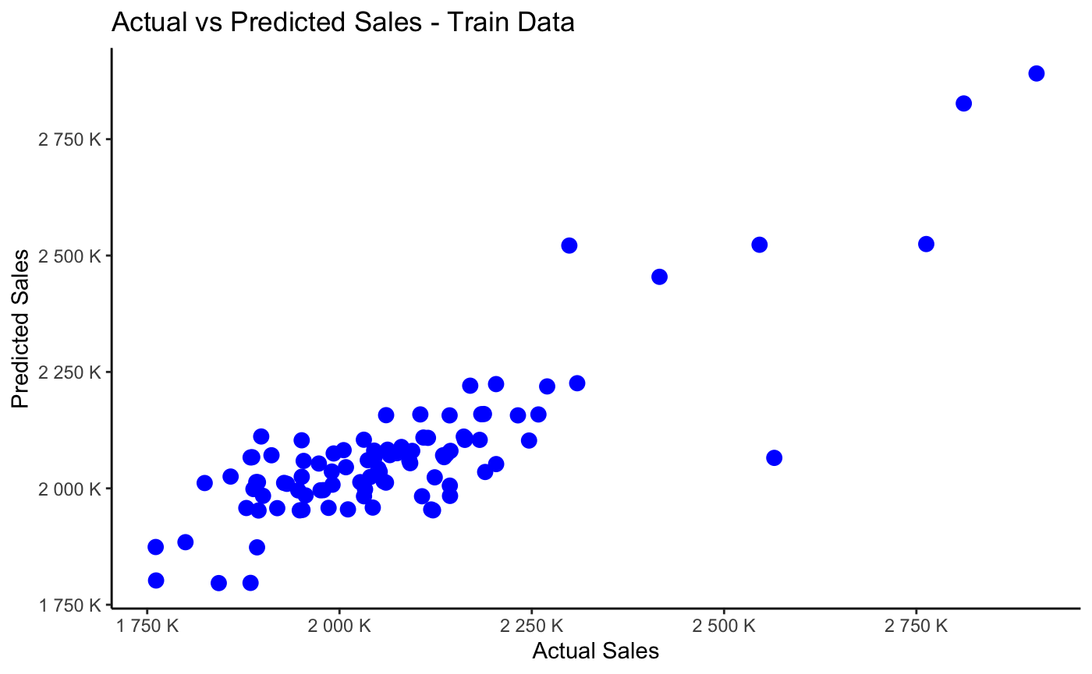
Prediction

Slide 14
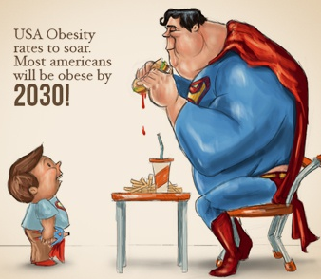
Observations and Conclusions
Lack of exercise is the obvious and the most significant variable leading to Adult Obesity, followed by the Smoking rate.​
Poverty was the only negative significant predictor
No car turned out to be the only non-significant predictor
84% of the data can be explained using the 5 predictor variables used in our model.​
Obesity Rates will increase with increase in Smokers, Number of people with a sedentary lifestyle and ,Poverty Rate
We are operating under the assumption that averages are approximately equal for all counties and difference in urban and rural setting rates is negligible.​

Slide 15
Caveats and Limitations
We are operating under the assumption that averages are approximately equal for all counties and difference in urban and rural setting rates is negligible.​
Healthcare, education​
Further analysis needs to be conducted to analyze the impact of obesity on healthcare education​

Slide 16
Thank You

